Slide 1
J J Û A S
Your friendly neighborhood financial manager ;)

Slide 2
OUR BIG IDEA
India has a growing middle class which is bigger than the entire population of the US. Our product targets this population and help them manage their finances judiciously i.e. aid them to invest, spend and save. We have calculated the ideal segregation of finances to ones fundamental needs.

Slide 3



OUR SERVICES
Personalized service
We tailor the expenses based on their age, income, marital status and responsibilities
Availability
To every member of the working class
Custom solutions
Its customizable based on the customer's responsibilities
Connections
We have collaborated to many other companies to make the ideal investment
Preferred loyalty programs
The app is freemium. By upgrading the customer can access the investing portals directly without hassle
Economies of scale
Our economics of scale are fairly high due our small team with a powerful algorithm

Slide 4
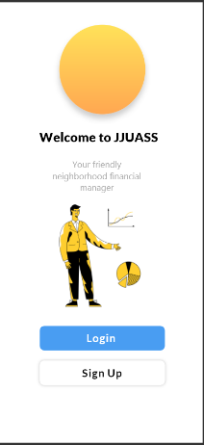
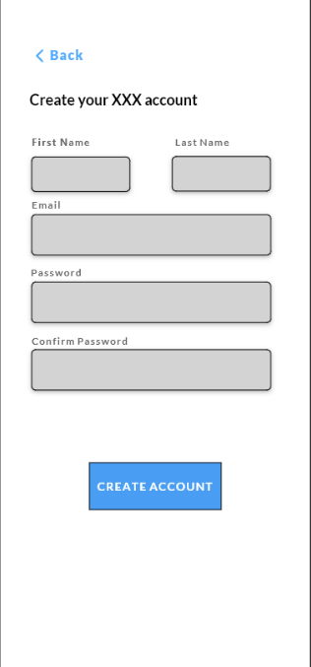
OUR APP:

Slide 5
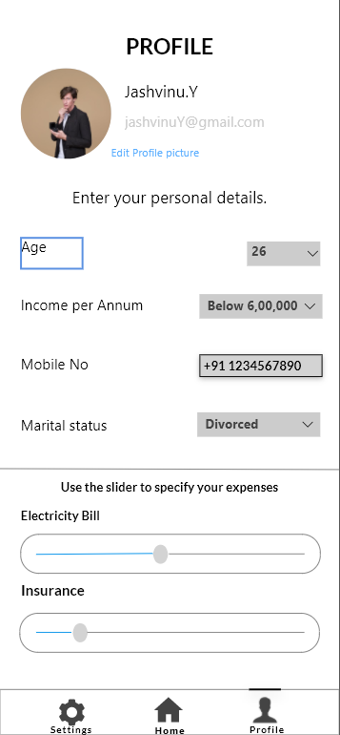


Slide 6
THE MARKET: Our competitors
27%
5%
17%
7%
6%
Customer 1
Customer 2
Customer 3
Customer 4
Customer 5
CUSTOMERS | GROWTH | YR1 | YR2 | YR3
Our customer | 27% | 141,000 | 150,870 | Rs.161,431
Bank 1 customer | 5% | Rs.63,000 | Rs.66,150 | Rs.69,457
Broker 1 customer | 10% | Rs.51,000 | Rs.56,100 | Rs.61,710
Broker 2 customer | 7%* | Rs.21,000 | Rs.22,470 | Rs.24,043
Bank 2 customer | 6.4%** | Rs.24,000 | Rs.25,536 | Rs.27,170

Slide 7


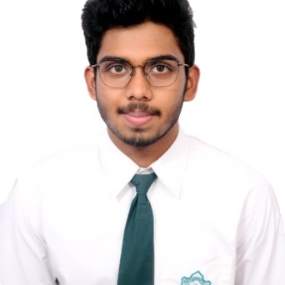

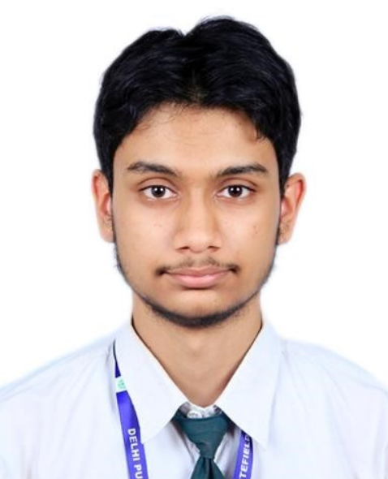
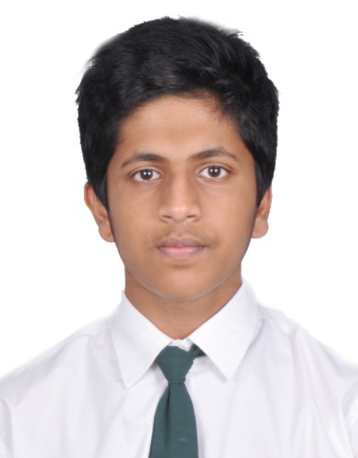
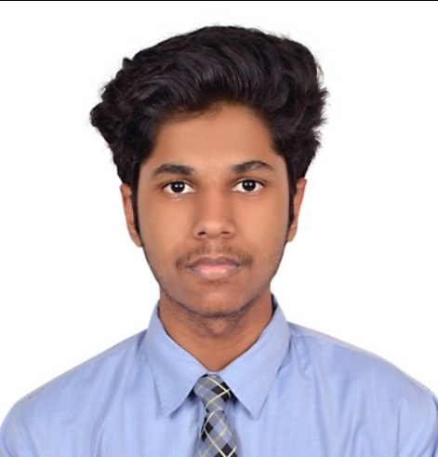
THE TEAM
Saksham Jain
COO
Jashvinu Y
Owner
Udayan Borah
CEO
Jawwad
CTO
Agneya Anoop
XU/XI
Sai Ruthvik
Developer

Slide 8




jjuas team
jjuas@gmail.com
8928598430

